Slide 1
Java JDBC
Presented by
Gauttam Sonkamble

Slide 2
Introduction
JDBC stands for Java Database Connectivity. JDBC is a Java API to connect and execute the query with the database. It is a part of JavaSE (Java Standard Edition). JDBC API uses JDBC drivers to connect with the database. There are four types of JDBC drivers:
JDBC-ODBC Bridge Driver,
Native Driver,
Network Protocol Driver, and
Thin Driver
Notes:
How presentation will benefit audience: Adult learners are more interested in a subject if they know how or why it is important to them.
Presenter’s level of expertise in the subject: Briefly state your credentials in this area, or explain why participants should listen to you.

Slide 3
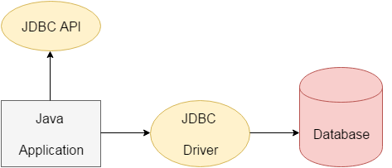
We can use JDBC API to access tabular data stored in any relational database. By the help of JDBC API, we can save, update, delete and fetch data from the database. It is like Open Database Connectivity (ODBC) provided by Microsoft.
Notes:
Lesson descriptions should be brief.

Slide 4
The java.sql package contains classes and interfaces for JDBC API. A list of popular interfaces of JDBC API are given below:
}
}
Driver interface
Connection interface
Statement interface
PreparedStatement interface
CallableStatement interface
ResultSet interface
ResultSetMetaData interface
DatabaseMetaData interface
RowSet interface
Notes:
Example objectives
At the end of this lesson, you will be able to:
Save files to the team Web server.
Move files to different locations on the team Web server.
Share files on the team Web server.

Slide 5
A list of popular classes of JDBC API are given below: DriverManager class Blob class Clob class Types class

Slide 6
Why Should We Use JDBC
Before JDBC, ODBC API was the database API to connect and execute the query with the database. But, ODBC API uses ODBC driver which is written in C language (i.e. platform dependent and unsecured). That is why Java has defined its own API (JDBC API) that uses JDBC drivers (written in Java language).
We can use JDBC API to handle database using Java program and can perform the following activities:
Connect to the database
Execute queries and update statements to the database
Retrieve the result received from the database.

Slide 7
What is API?
API (Application programming interface) is a document that contains a description of all the features of a product or software. It represents classes and interfaces that software programs can follow to communicate with each other. An API can be created for applications, libraries, operating systems, etc.

Slide 8
JDBC Driver
JDBC Driver is a software component that enables java application to interact with the database. There are 4 types of JDBC drivers:
JDBC-ODBC bridge driver
Native-API driver (partially java driver)
Network Protocol driver (fully java driver)
Thin driver (fully java driver)

Slide 9
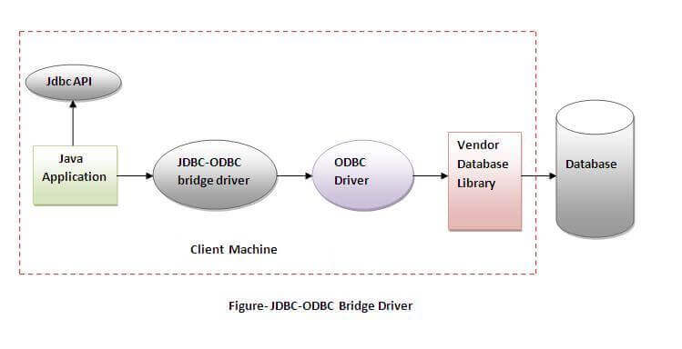
JDBC-ODBC bridge driver
The JDBC-ODBC bridge driver uses ODBC driver to connect to the database. The JDBC-ODBC bridge driver converts JDBC method calls into the ODBC function calls.

Slide 10
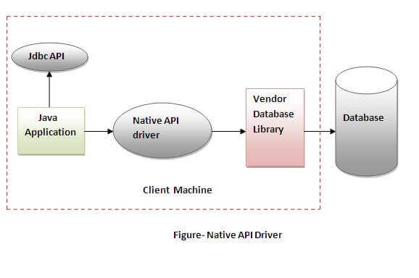
Native-API driver
The Native API driver uses the client-side libraries of the database. The driver converts JDBC method calls into native calls of the database API. It is not written entirely in java.

Slide 11
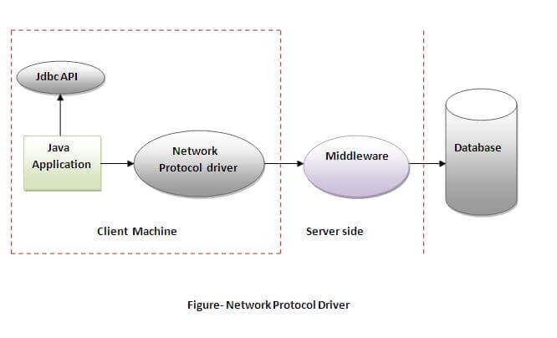
Network Protocol driver
The Network Protocol driver uses middleware (application server) that converts JDBC calls directly or indirectly into the vendor-specific database protocol. It is fully written in java.

Slide 12
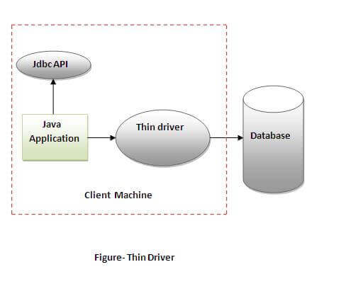
Thin driver
The thin driver converts JDBC calls directly into the vendor-specific database protocol. That is why it is known as thin driver. It is fully written in Java language.

Slide 13
Java Database Connectivity Steps:
There are 5 steps to connect any java application with the database using JDBC. These steps are as follows:
Register the Driver class
Create connection
Create statement
Execute queries
Close connection

Slide 14
1) Register the driver class
The forName() method of Class is used to register the driver class. This method is used to dynamically load the driver class.
Syntax of forName() method
public static void forName(String className)throws ClassNotFoundException .
Example to register the OracleDriver class
Here, Java program is loading oracle driver to esteblish database connection.
Class.forName("oracle.jdbc.driver.OracleDriver");

Slide 15
2) Create the connection object
The getConnection() method of DriverManager class is used to establish connection with the database.
Syntax of getConnection() method
1) public static Connection getConnection(String url)throws SQLException
2) public static Connection getConnection(String url,String name,String password)
throws SQLException
Example to establish connection with the Oracle database
Connection con=DriverManager.getConnection(
"jdbc:oracle:thin:@localhost:8080:xe","system","password");

Slide 16
3) Create the Statement object
The createStatement() method of Connection interface is used to create statement. The object of statement is responsible to execute queries with the database.
Syntax of createStatement() method
public Statement createStatement()throws SQLException
Example to create the statement object
Statement stmt=con.createStatement();

Slide 17
4.Execute the query
The executeQuery() method of Statement interface is used to execute queries to the database. This method returns the object of ResultSet that can be used to get all the records of a table.
Syntax of executeQuery() method
public ResultSet executeQuery(String sql)throws SQLException
Example to execute query
ResultSet rs=stmt.executeQuery("select * from emp");
while(rs.next()){
System.out.println(rs.getInt(1)+" "+rs.getString(2));
}

Slide 18
Close the connection object
By closing connection object statement and ResultSet will be closed automatically. The close() method of Connection interface is used to close the connection.
Syntax of close() method
public void close()throws SQLException
Example to close connection
con.close();

Slide 19
Java Database Connectivity with MySQL
Driver class: The driver class for the mysql database is com.mysql.jdbc.Driver.
Connection URL: The connection URL for the mysql database is jdbc:mysql://localhost:3306/sonoo where jdbc is the API, mysql is the database, localhost is the server name on which mysql is running, we may also use IP address, 3306 is the port number and emp is the database name. We may use any database, in such case, we need to replace the emp with our database name.
Username: The default username for the mysql database is root.
Password: It is the password given by the user at the time of installing the mysql database. In this example, we are going to use root as the password.

Slide 20
Let's first create a table in the mysql database, but before creating table, we need to create database first.
create database emp;
use emp;
create table empdata(id int(10),name varchar(40),age int(3));
Example to Connect Java Application with mysql database
In this example, emp is the database name, root is the username and password both.

Slide 21
import java.sql.*;
class MysqlCon{
public static void main(String args[]){
try{
Class.forName("com.mysql.jdbc.Driver");
Connection con=DriverManager.getConnection(
"jdbc:mysql://localhost:3306/emp","root","root");
//here emp is database name, root is username and password
Statement stmt=con.createStatement();
ResultSet rs=stmt.executeQuery("select * from emp");
while(rs.next())
System.out.println(rs.getInt(1)+" "+rs.getString(2)+" "+rs.getString(3));
con.close();
}catch(Exception e){ System.out.println(e);}
}
}

Slide 22
To connect java application with the mysql database, mysqlconnector.jar file is required to be loaded.
Download mysqlconnector jar

Slide 23
Statement

